Slide 1
Introduction to Python
TS Phan Thanh Toàn

Slide 2
Objectives
Introduction to Python
Python features
First Python Program
Python basic syntax components: Identifier, statement, comment

Slide 3
Introduction to Python
Python
  Is a general-purpose interpreted, interactive, object-oriented, and high-level programming language. It was created by Guido van Rossum during 1985- 1990.
History of Python
  Python was developed by Guido van Rossum in the late eighties and early nineties at the National Research Institute for Mathematics and Computer Science in the Netherlands.
  Python is derived from many other languages, including ABC, Modula-3, C, C++, Algol-68, SmallTalk, and Unix shell and other scripting languages.
  Python is copyrighted. Like Perl, Python source code is now available under the GNU General Public License (GPL).
  Python is now maintained by a core development team at the institute, although Guido van Rossum still holds a vital role in directing its progress.

Slide 4

Characteristics of Python
Following are important characteristics of Python Programming −
  It supports functional and structured programming methods as well as OOP.
  It can be used as a scripting language or can be compiled to byte-code for building large applications.
  It provides very high-level dynamic data types and supports dynamic type checking.
  It supports automatic garbage collection.
  It can be easily integrated with C, C++, COM, ActiveX, CORBA, and Java.
Example Hello World using Python

Slide 5
Python - Environment Setup
Getting Python
  The most up-to-date and current source code, binaries, documentation, news, etc., is available on the official website of Python https://www.python.org/
  You can download Python documentation from https://www.python.org/doc/. The documentation is available in HTML, PDF, and PostScript formats.
Installing Python
  Python distribution is available for a wide variety of platforms. You need to download only the binary code applicable for your platform and install Python.
  If the binary code for your platform is not available, you need a C compiler to compile the source code manually. Compiling the source code offers more flexibility in terms of choice of features that you require in your installation.

Slide 6
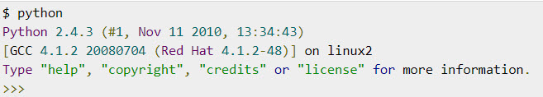

First Python Program
Let us execute programs in different modes of programming.
  Interactive Mode Programming
    Invoking the interpreter without passing a script file as a parameter brings up the following prompt
    Type the following text at the Python prompt and press the Enter

Slide 7
Trình soạn thảo online
Một số trình soạn thảo Python online hữu ích (không cần phải cài đặt trên máy tính cá nhân):
  https://www.onlinegdb.com/online_python_compiler
  https://replit.com/~
  https://pynative.com/online-python-code-editor-to-execute-python-code/

Slide 8

First Python Program
Script Mode Programming
  Invoking the interpreter with a script parameter begins execution of the script and continues until the script is finished. When the script is finished, the interpreter is no longer active.
  Let us write a simple Python program in a script. Python files have extension .py. Type the following source code in a test.py file
  Now, try to run this program as follows
  Output

Slide 9
Python Identifiers
A Python identifier is a name used to identify a variable, function, class, module or other object. An identifier starts with a letter A to Z or a to z or an underscore (_) followed by zero or more letters, underscores and digits (0 to 9).
Python does not allow punctuation characters such as @, $, and % within identifiers. Python is a case sensitive programming language. Thus, Manpower and manpower are two different identifiers in Python.
The rules to name an identifier are given below.
  The first character of the variable must be an alphabet or underscore ( _ ).
  All the characters except the first character may be an alphabet of lower-case(a-z), upper-case (A-Z), underscore, or digit (0-9).
  Identifier name must not contain any white-space, or special character (!, @, #, %, ^, &, *).
  Identifier name must not be similar to any keyword defined in the language.
  Identifier names are case sensitive; for example, my name, and MyName is not the same.
  Examples of valid identifiers: a123, _n, n_9, etc.
  Examples of invalid identifiers: 1a, n%4, n 9, etc.

Slide 10
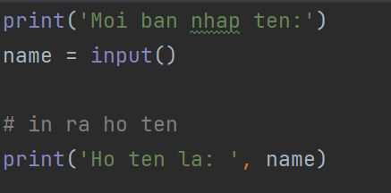
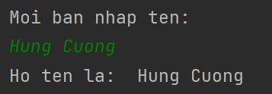
Ví dụ nhập dữ liệu
Nhập giá trị từ bàn phím:
Kết quả:

Slide 11
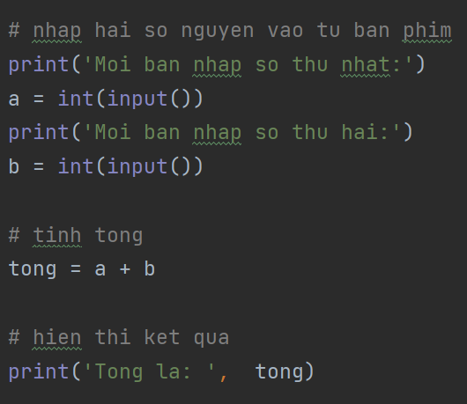
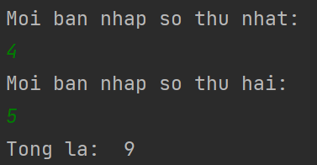
Ví dụ nhập dữ liệu
Nhập hai số từ bàn phím:
Kết quả:

Slide 12
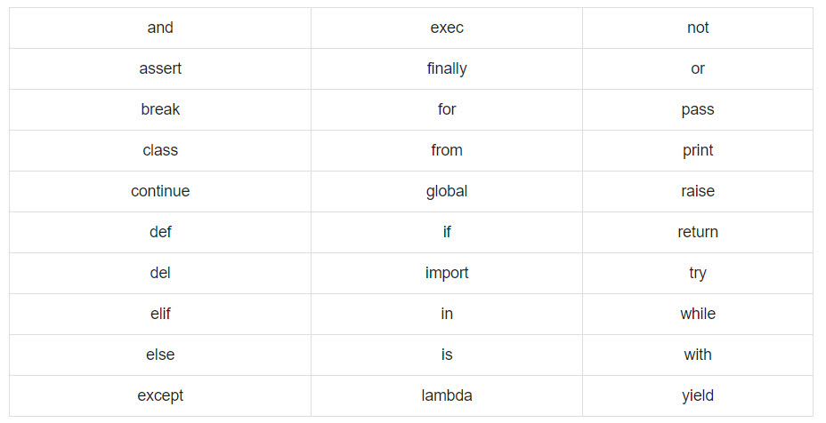
Keywords
The following list shows the Python keywords. These are reserved words and you cannot use them as constant or variable or any other identifier names. All the Python keywords contain lowercase letters only.

Slide 13
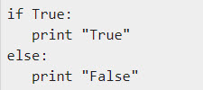
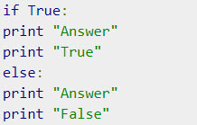
Lines and Indentation
Python provides no braces to indicate blocks of code for class and function definitions or flow control. Blocks of code are denoted by line indentation, which is rigidly enforced.
The number of spaces in the indentation is variable, but all statements within the block must be indented the same amount. For example
However, the following block generates an error −
Thus, in Python all the continuous lines indented with same number of spaces would form a block.

Slide 14


Multi-Line Statements
Statements in Python typically end with a new line. Python does, however, allow the use of the line continuation character (\) to denote that the line should continue. For example −
Statements contained within the [], {}, or () brackets do not need to use the line continuation character. For example −

Slide 15
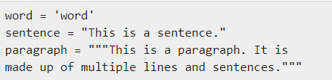
Quotation in Python
Python accepts single ('), double (") and triple (''' or """) quotes to denote string literals, as long as the same type of quote starts and ends the string.
The triple quotes are used to span the string across multiple lines. For example, all the following are legal −

Slide 16

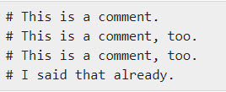
Comments in Python
A hash sign (#) that is not inside a string literal begins a comment. All characters after the # and up to the end of the physical line are part of the comment and the Python interpreter ignores them.
You can comment multiple lines as follows −

Slide 17
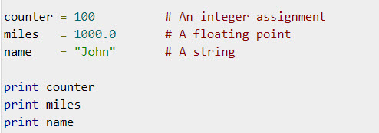
Python - Variable Types
Variables are nothing but reserved memory locations to store values. This means that when you create a variable you reserve some space in memory.
Based on the data type of a variable, the interpreter allocates memory and decides what can be stored in the reserved memory. Therefore, by assigning different data types to variables, you can store integers, decimals or characters in these variables.
Assigning Values to Variables
  Python variables do not need explicit declaration to reserve memory space. The declaration happens automatically when you assign a value to a variable. The equal sign (=) is used to assign values to variables.
  The operand to the left of the = operator is the name of the variable and the operand to the right of the = operator is the value stored in the variable. For example −

Slide 18


Multiple Assignment
Python allows you to assign a single value to several variables simultaneously. For example −
Here, an integer object is created with the value 1, and all three variables are assigned to the same memory location. You can also assign multiple objects to multiple variables. For example −
Here, two integer objects with values 1 and 2 are assigned to variables a and b respectively, and one string object with the value "john" is assigned to the variable c.

Slide 19
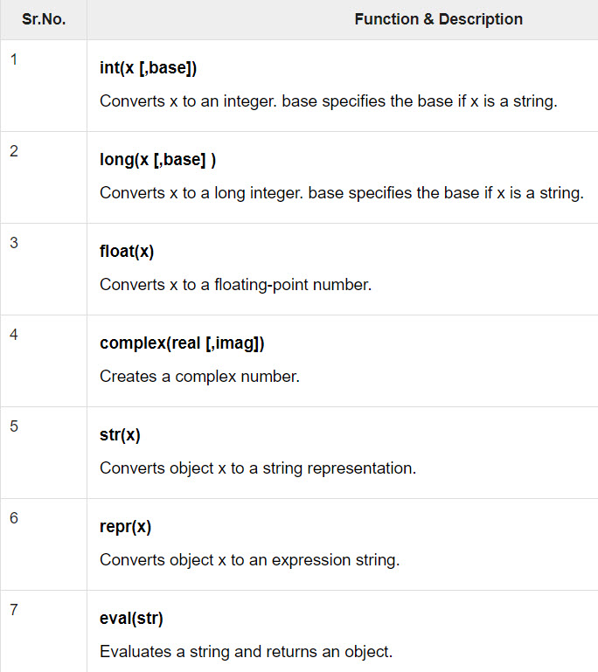
Data Type Conversion
Sometimes, you may need to perform conversions between the built-in types. To convert between types, you simply use the type name as a function.
There are several built-in functions to perform conversion from one data type to another. These functions return a new object representing the converted value.

Slide 20
Python - Basic Operators
Operators are the constructs which can manipulate the value of operands.
  Consider the expression 4 + 5 = 9. Here, 4 and 5 are called operands and + is called operator.
Types of Operator
  Python language supports the following types of operators.
    Arithmetic Operators
    Comparison (Relational) Operators
    Assignment Operators
    Logical Operators
    Bitwise Operators
    Membership Operators
    Identity Operators

Slide 21
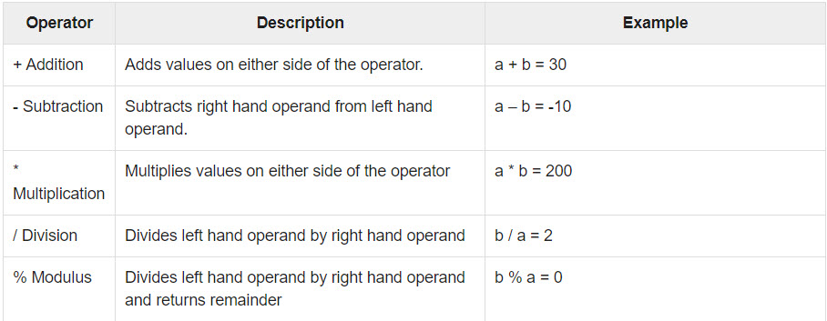
Python - Basic Operators
Python Arithmetic Operators
  Assume variable a holds 10 and variable b holds 20, then −

Slide 22
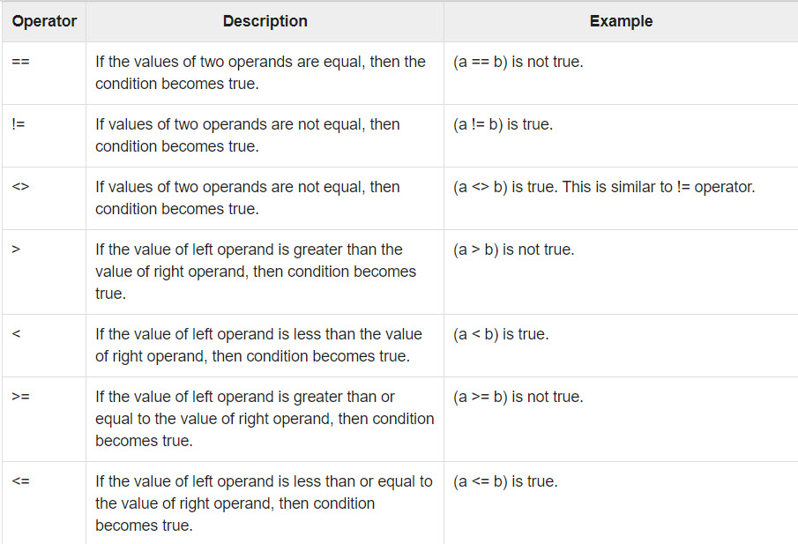
Python - Basic Operators
Python Comparison Operators
  These operators compare the values on either sides of them and decide the relation among them. They are also called Relational operators.
  Assume variable a holds 10 and variable b holds 20, then −

Slide 23
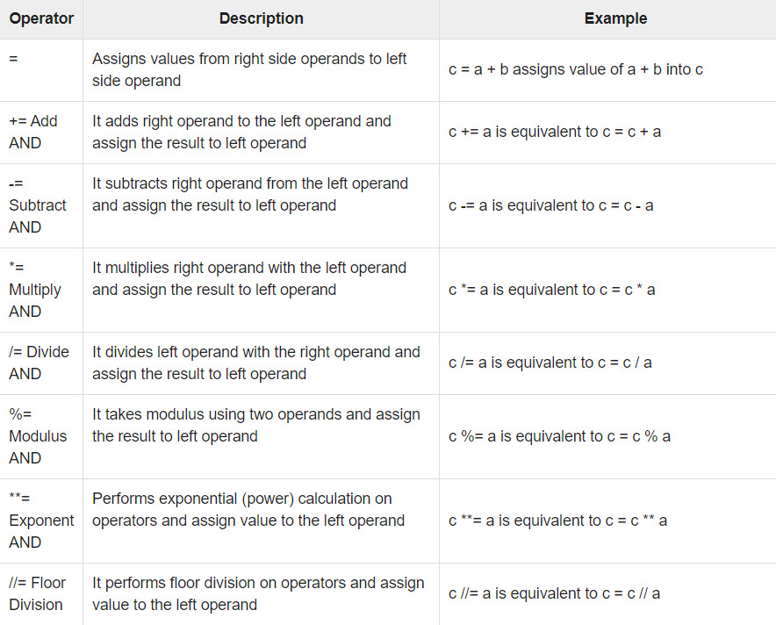
Python - Basic Operators
Python Assignment Operators
  Assume variable a holds 10 and variable b holds 20, then −

Slide 24
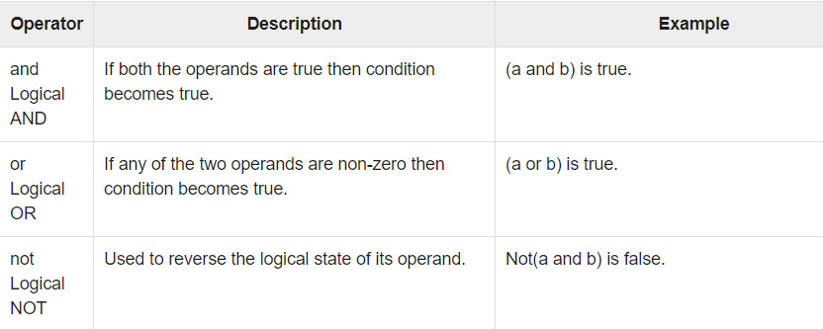
Python - Basic Operators
Python Logical Operators
  There are following logical operators supported by Python language. Assume variable a holds 10 and variable b holds 20 then

Slide 25
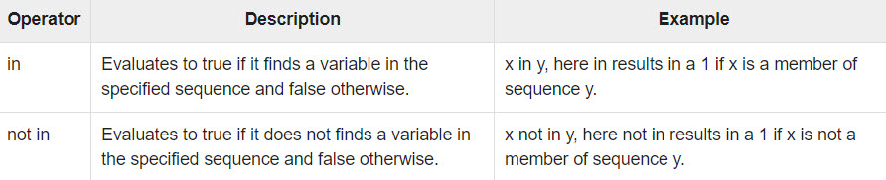
Python - Basic Operators
Python Membership Operators
  Python’s membership operators test for membership in a sequence, such as strings, lists, or tuples. There are two membership operators as explained below −

Slide 26
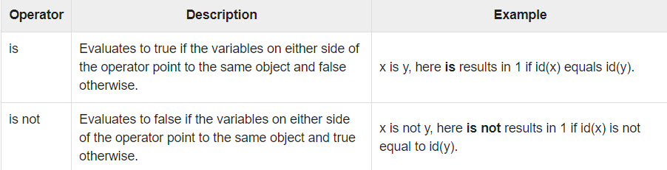
Python - Basic Operators
Python Identity Operators
  Identity operators compare the memory locations of two objects. There are two Identity operators explained below −

Slide 27
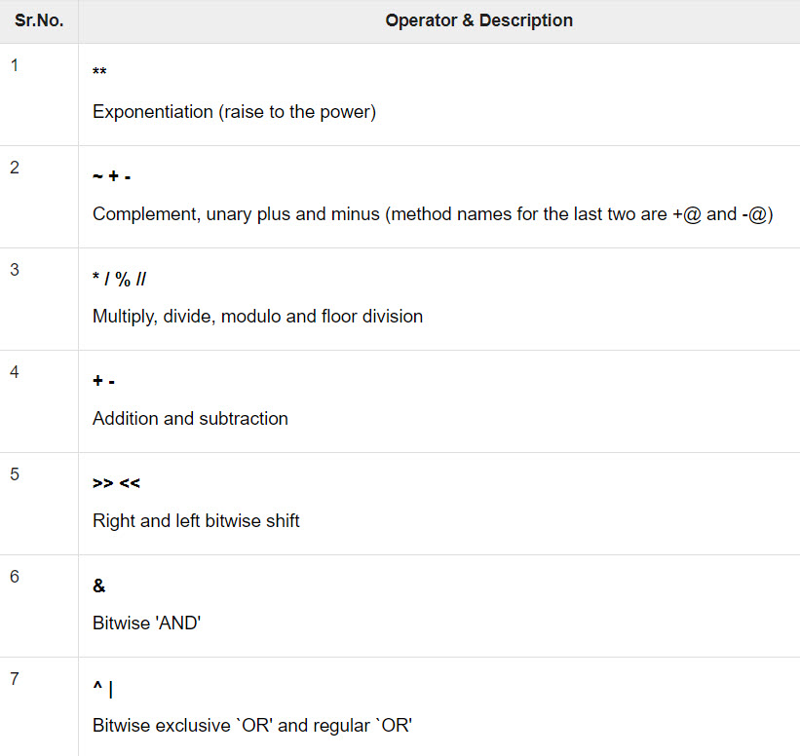
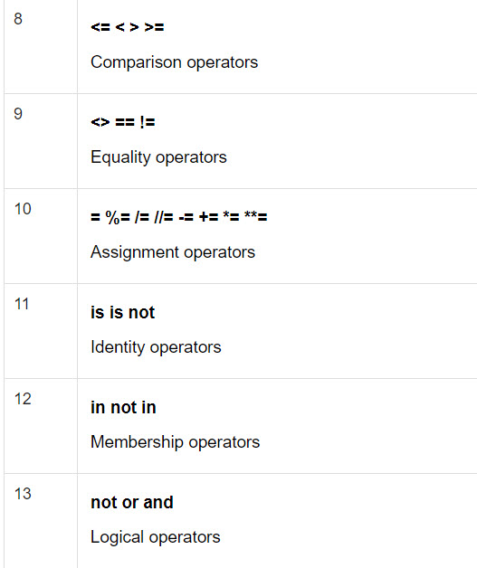
Python - Basic Operators
Python Operators Precedence
  The following table lists all operators from highest precedence to lowest.

Slide 28
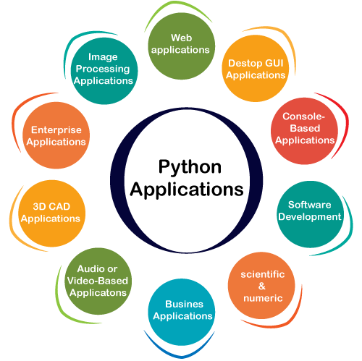
Python Applications

Slide 29
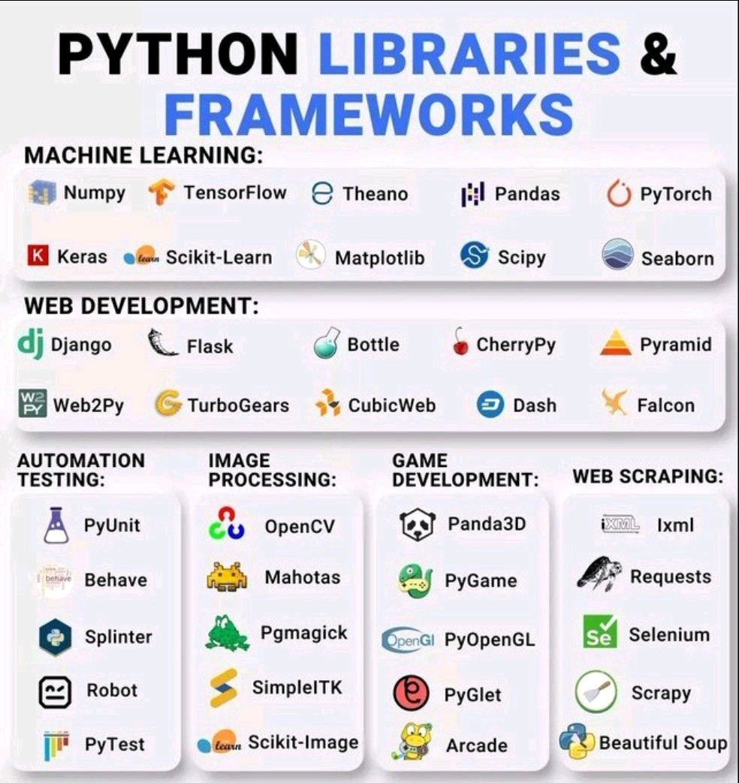
Python Libraries & Frameworks

Slide 30
Summary
Introduction to Python
Python features
First Python Program
Python basic syntax components: Identifier, statement, comment

